Slide 1
Basics of Computer Animation

Slide 5
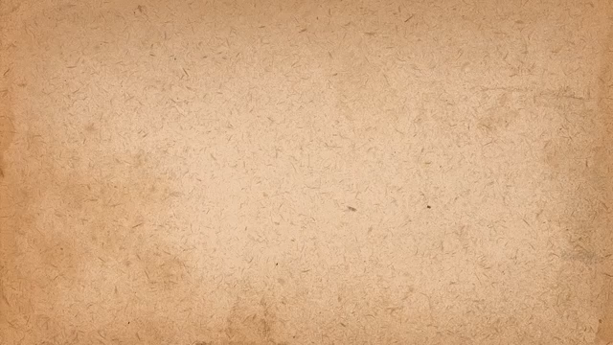
For full video
https://https://www.youtube.com/watch?v=uDqjIdI4bF4

Slide 9
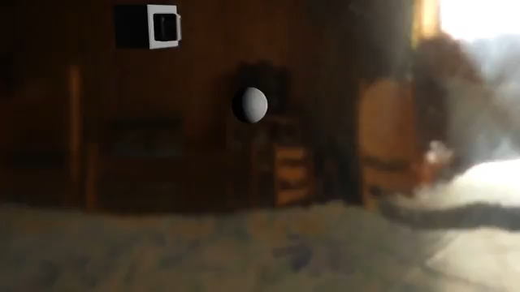

Slide 11
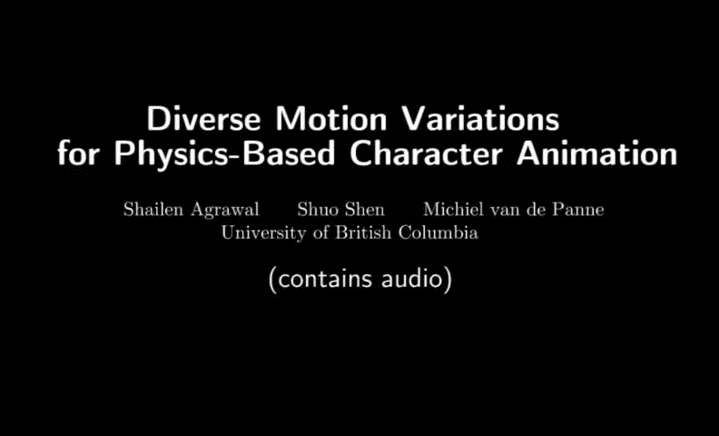

Slide 17
Facial motion capture
https://www.youtube.com/watch?v=uNK8S19OSmA
markerless facial motion capture
https://www.youtube.com/watch?v=24qUFDdZAG8

Slide 21
Skinning mesh animations
https://www.youtube.com/watch?v=pvntRFQQTM4

